Slide 1


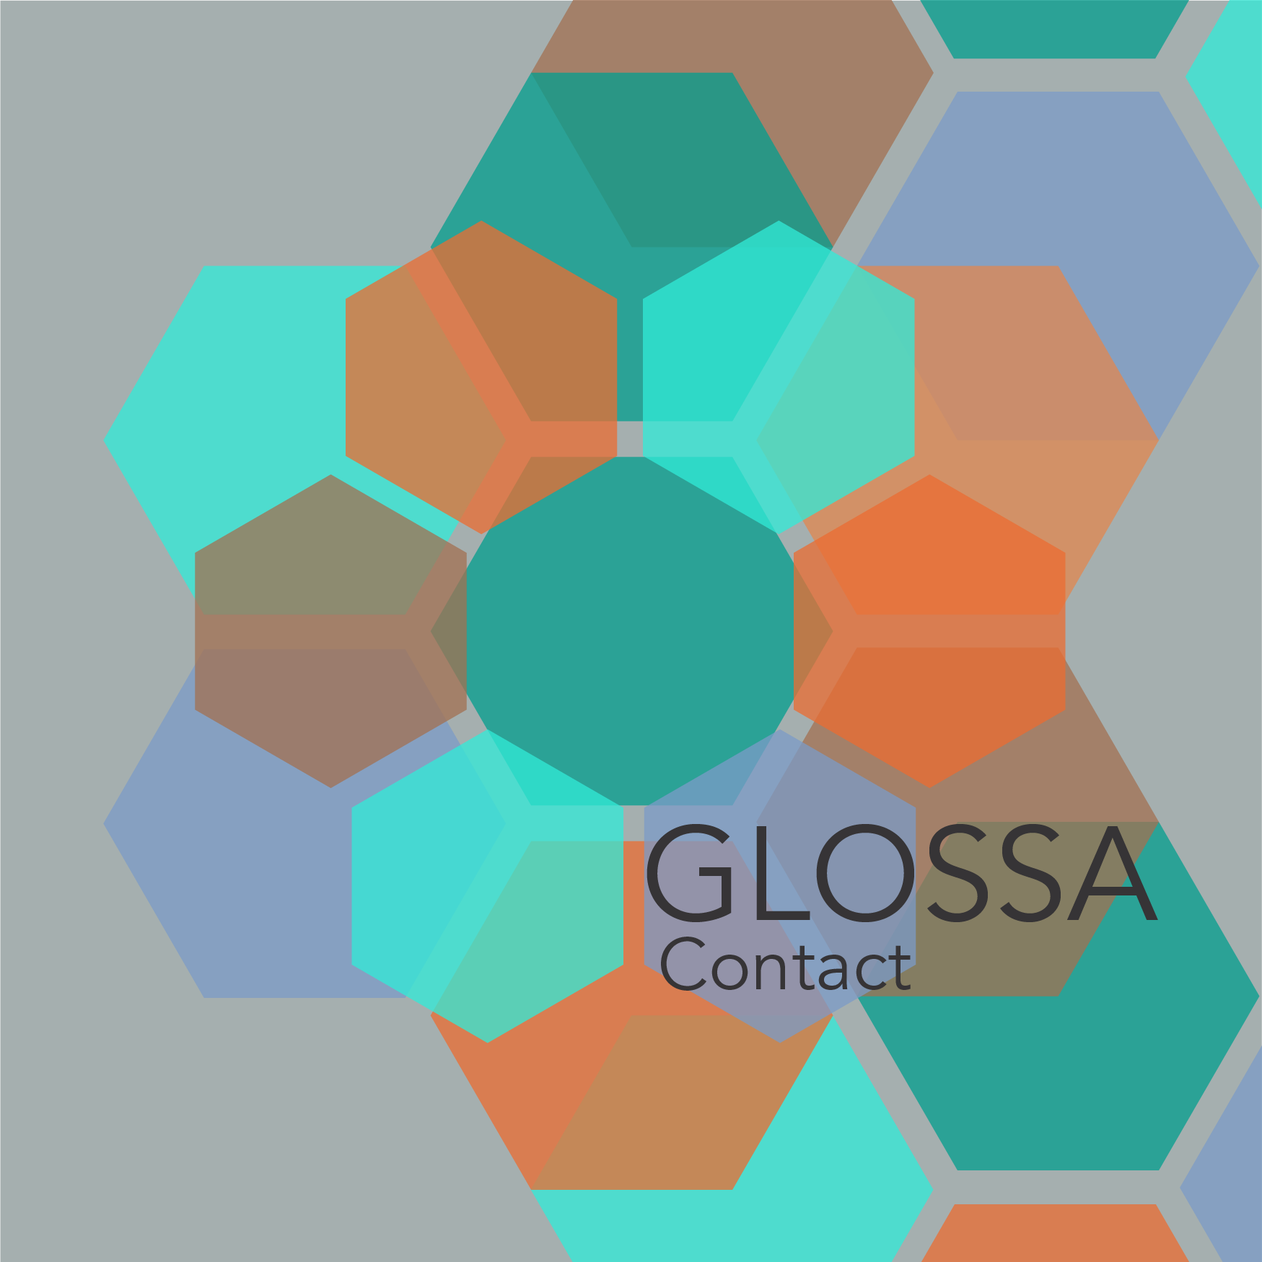
Lavidas Perspectives for ARCAS Session
AthDGC contributions

Slide 2
AthDGC + ARCAS Alignment
Joint mission on historical languages
Shared infrastructure
Complementary expertise

Slide 3
Lavidas' Ideas
Translation chains as sensors
Graph representations for canon
Periphrastic focus areas

Slide 4
AthDGC Assets
Annotated corpora
Valency lexica
Community of annotators

Slide 5
Next Joint Steps
Define co-authored study
Deploy shared tools
Plan Athens follow-up visit

